Slide 1
Lecture 4 Deep Learning
CS 180 – Intelligent Systems
Dr. Victor Chen
Fall 2022

Slide 2
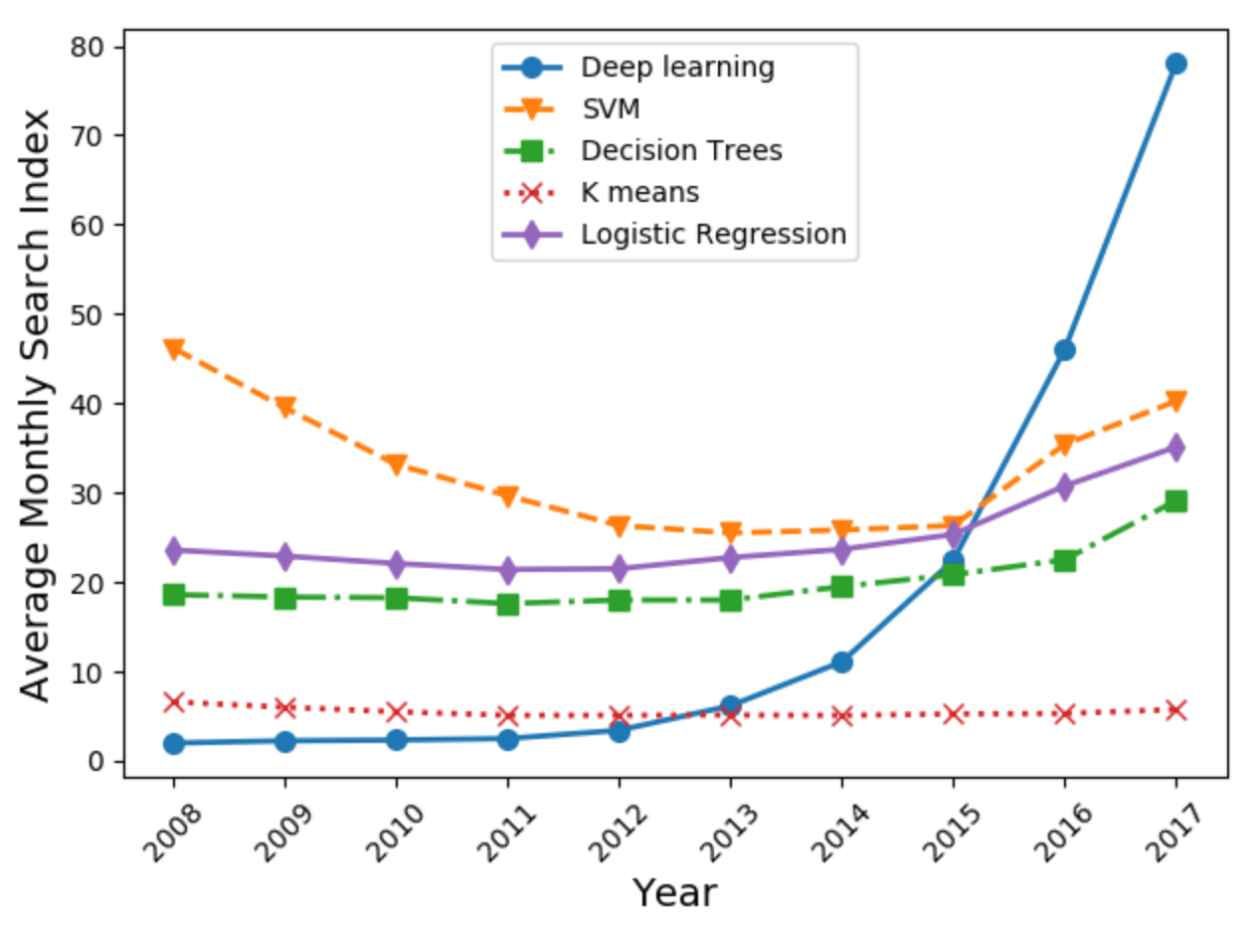
Deep learning gaining popularity

Slide 3
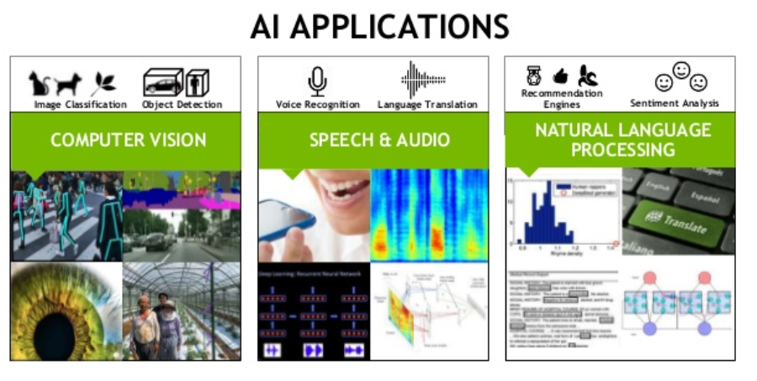
Deep learning today
https://experiments.withgoogle.com/collection/ai

Slide 4
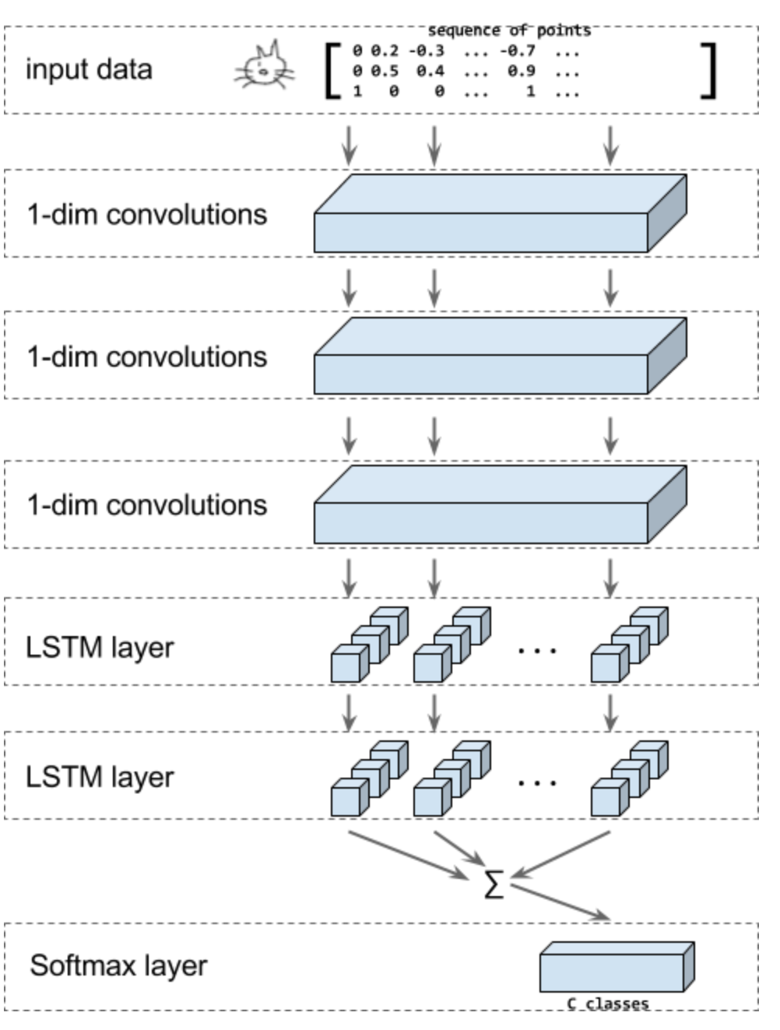
Demo
https://quickdraw.withgoogle.com/
The model takes sequences of strokes as input.

Slide 5
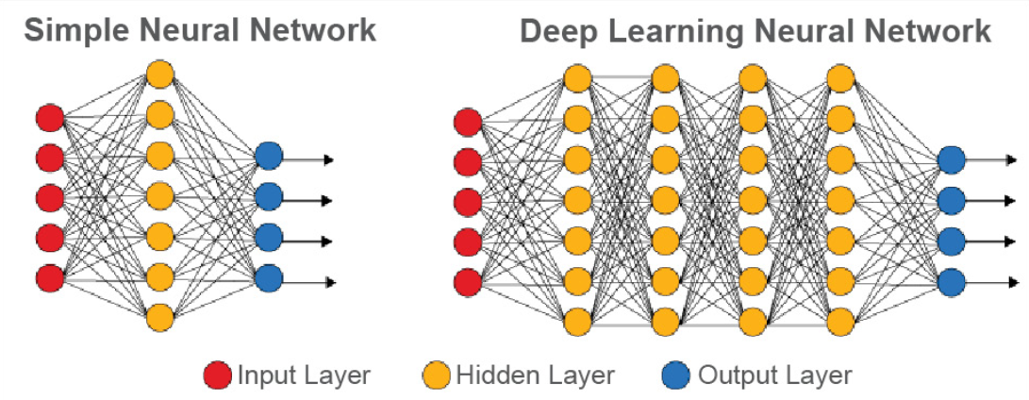
Deep learning in a nutshell
“Regular" neural networks usually have
one to two hidden layers
are used for SUPERVISED learning.
“Deep” neural networks have
more hidden layers
can be used for both UNSUPERVISED and SUPERVISED learning.

Slide 6
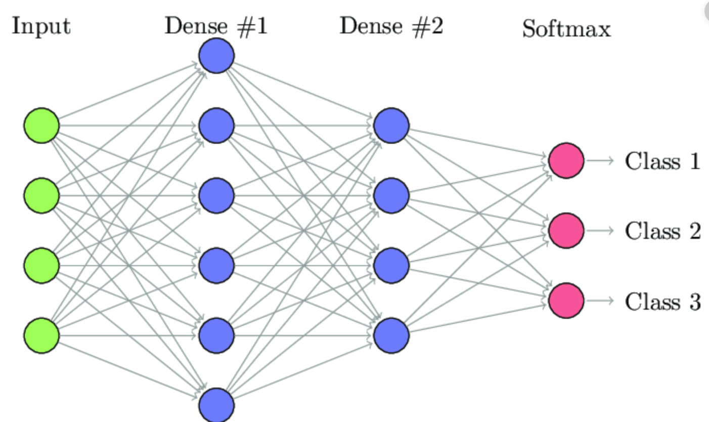
Regular neural network (dense/fully-connect neural network)

Slide 7
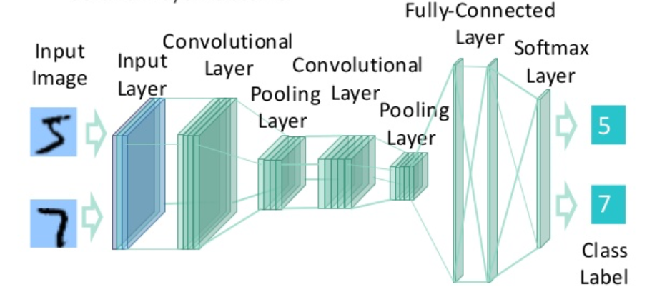
A deep network for recognizing handwritten digits

Slide 8

Why deep learning is generally better?

Slide 9
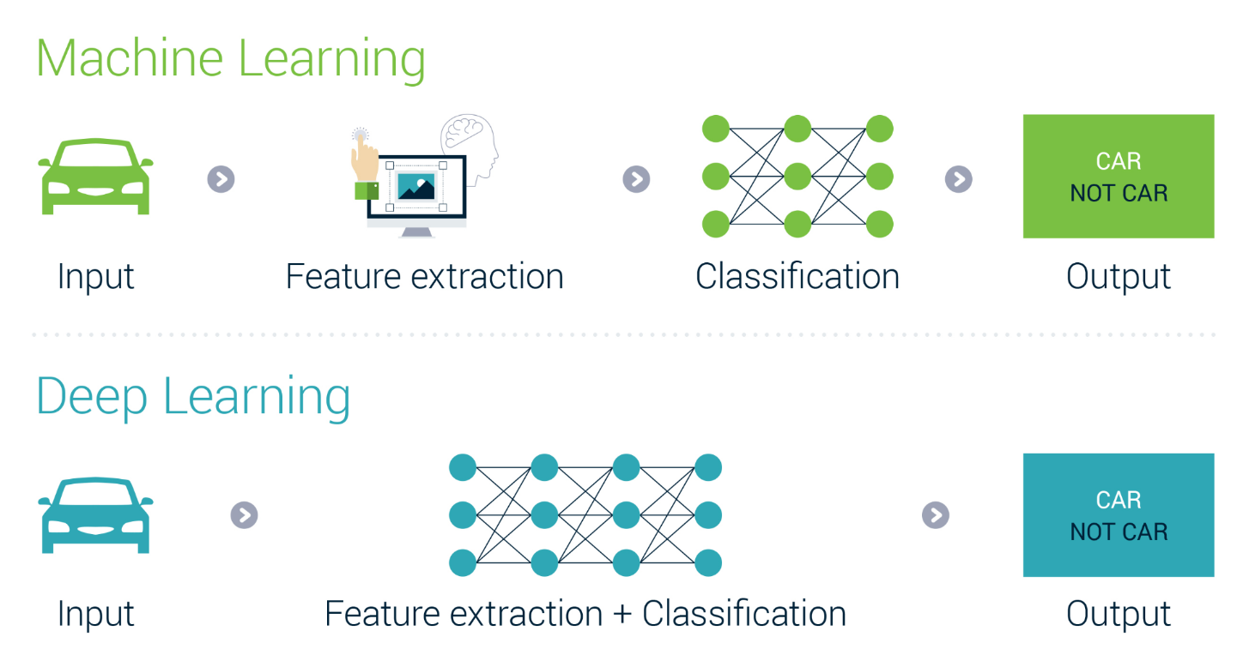
Feature detection using deep learning
“The hidden layers” can (1) detect “true underlying” features and (2) train model on those features

Slide 10
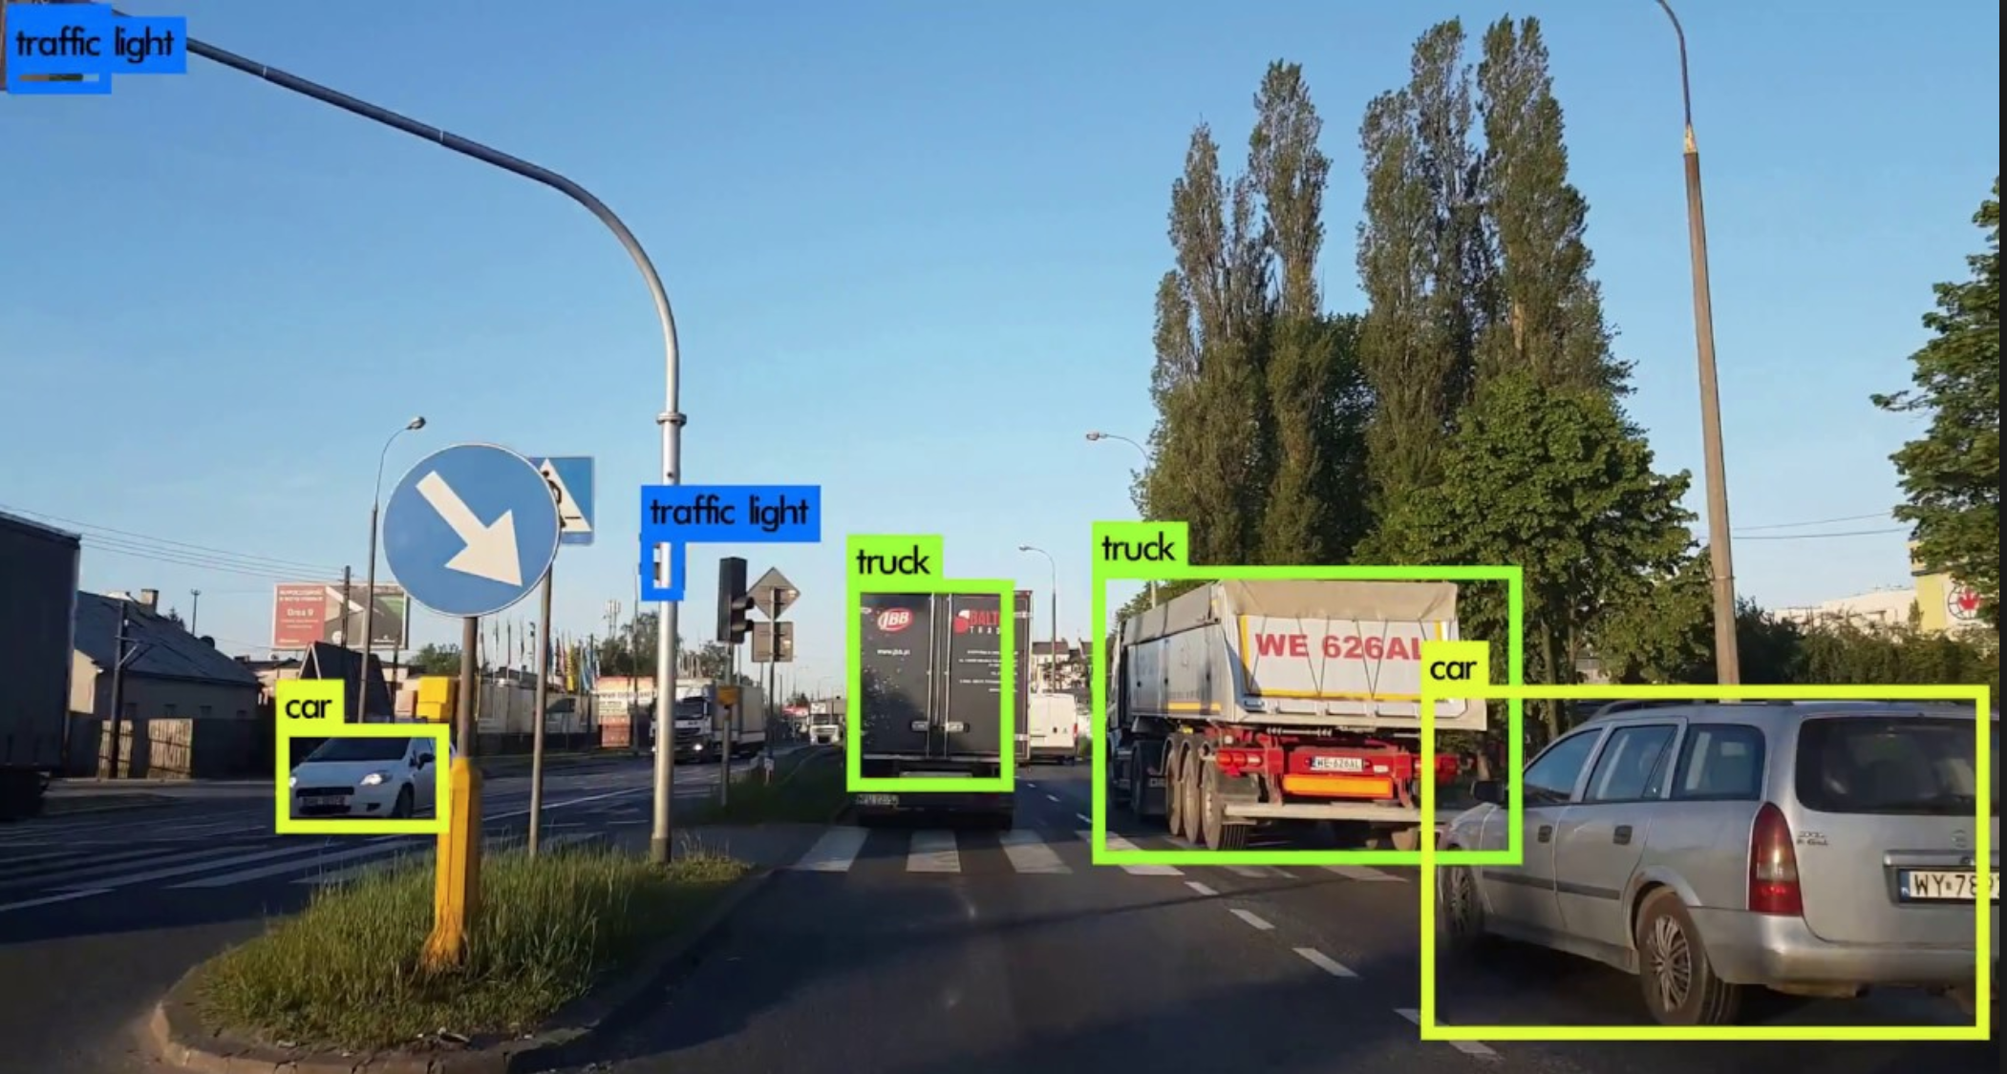
Object detection example

Slide 11
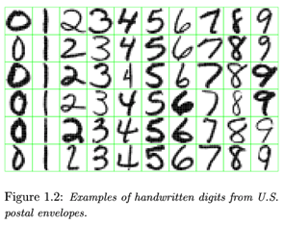
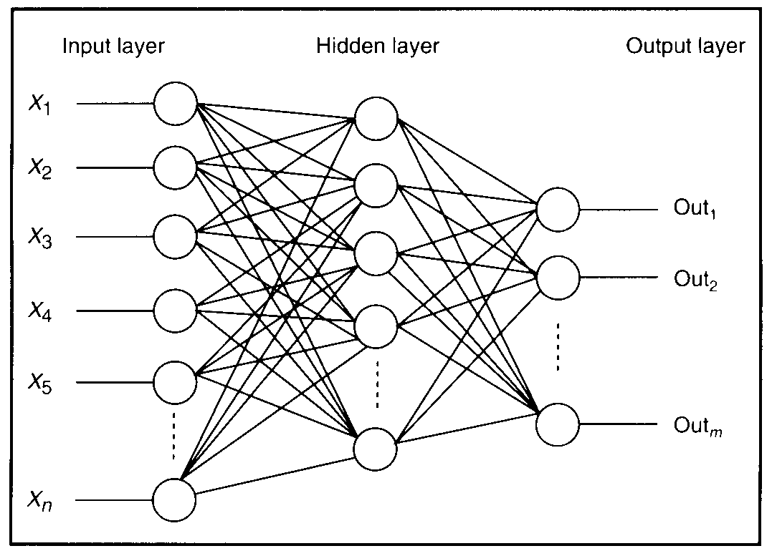
Feature detectors

Slide 12
What is this neuron doing?

Slide 13
Hidden layer neurons become feature detectors
1 5 10 15 20 25 …
…
1
strong weight
low/zero weight
63

Slide 14
Hidden layer neurons become feature detectors
1 5 10 15 20 25 …
…
1
strong weight
low/zero weight
63

Slide 15
Hidden layer neurons become feature detectors
1 5 10 15 20 25 …
…
1
strong +ve weight
low/zero weight
it will send strong signal for a horizontal
line in the top row, ignoring everywhere else
63

Slide 16
Another neuron
1 5 10 15 20 25 …
…
1
strong weight
low/zero weight
63

Slide 17
Another neuron
1 5 10 15 20 25 …
…
1
strong weight
low/zero weight
Strong signal for a red area in the top left
corner
63

Slide 18
What features do you think would make a good model?

Slide 19
vertical lines
1
63

Slide 20
Horizontal lines
1
63

Slide 21
Small circles
1
63

Slide 22
Hidden neurons can detect for
specific parts of an image
63

Slide 23
Hidden neurons can detect for
specific parts of an image
But what about correlation among different parts?
63

Slide 24
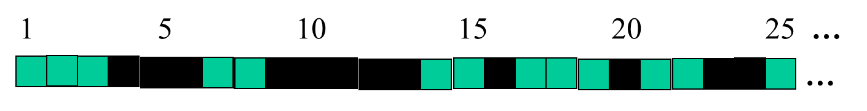
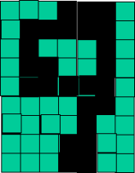
Successive layers can learn higher-level features
detect lines in
specific positions
etc …
Higher level detectors
( horizontal line,
“vertical lune”
“circle”, etc…
etc …
v

Slide 25
Successive layers can learn higher-level features
detect lines in
Specific positions
etc …
Higher level detetors
( horizontal line,
“RHS vertical lune”
“upper loop”, etc…
etc …
v
What does this unit detect?

Slide 26
That is how multiple layers make sense

Slide 27
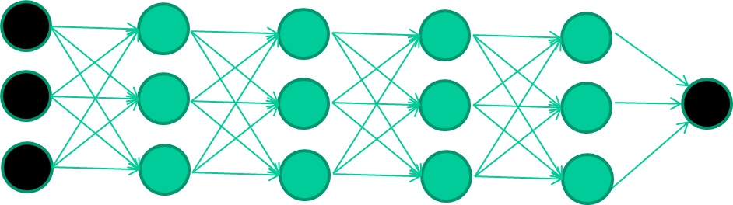
We want to stack many hidden layers to capture “true” features from lower levels to higher levels

Slide 28
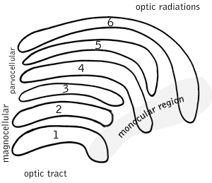
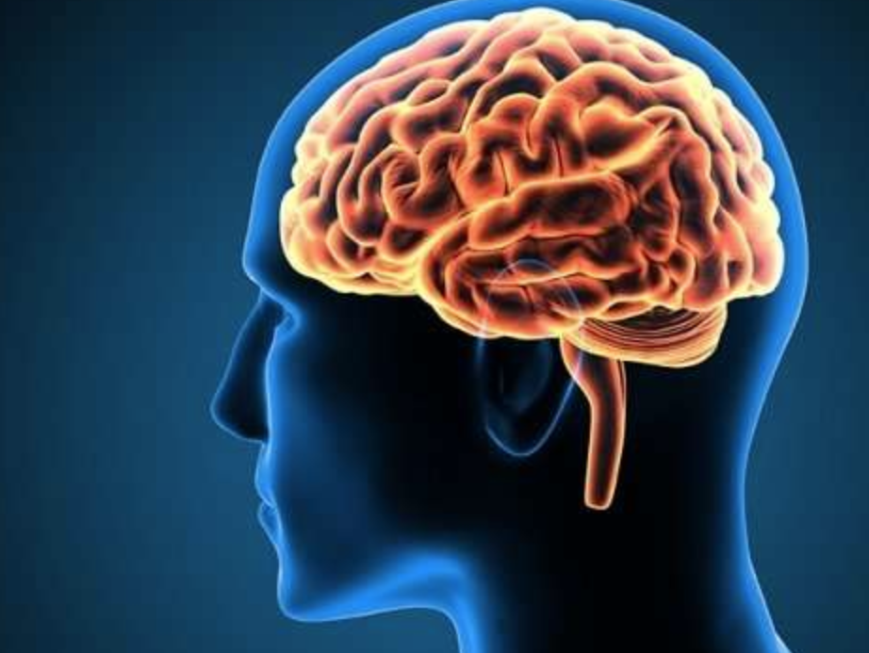
Successive layers can learn higher-level features
Your brain works that way

Slide 29
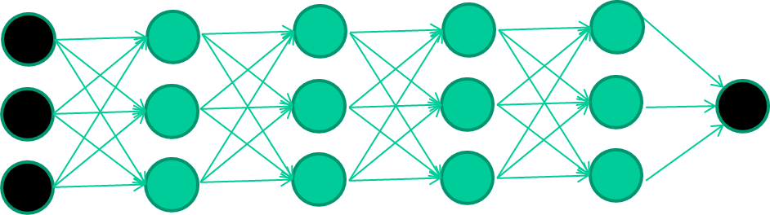
Review
How to train a neural network?

Slide 30
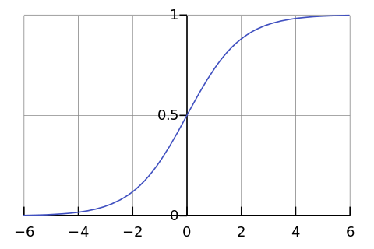
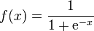
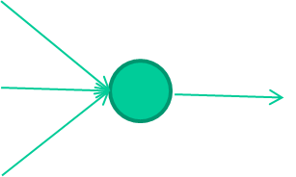
-0.06
W1
W2
f(x)
-2.5
W3
1.4

Slide 31
-0.06
2.7
-8.6
f(x)
-2.5
0.002
-0.06×2.7 + 2.5×8.6 + 1.4×0.002 = 21.34
sigmoid(21.34) = 0.99
1.4

Slide 32
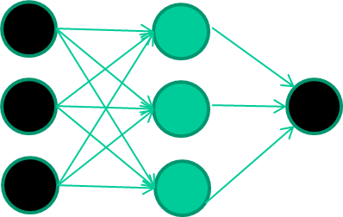
A dataset
Fields class
1.4 2.7 1.9 0
3.8 3.4 3.2 0
6.4 2.8 1.7 1
4.1 0.1 0.2 0
etc …

Slide 33
Training data
Fields class
1.4 2.7 1.9 0
3.8 3.4 3.2 0
6.4 2.8 1.7 1
4.1 0.1 0.2 0
etc …
Initialize model with random weights

Slide 34
Training data
Fields class
1.4 2.7 1.9 0
3.8 3.4 3.2 0
6.4 2.8 1.7 1
4.1 0.1 0.2 0
etc …
Present a training record
1.4
2.7
1.9

Slide 35
Training data
Fields class
1.4 2.7 1.9 0
3.8 3.4 3.2 0
6.4 2.8 1.7 1
4.1 0.1 0.2 0
etc …
Feed it through to get output
1.4
2.7 0.8
1.9

Slide 36
Training data
Fields class
1.4 2.7 1.9 0
3.8 3.4 3.2 0
6.4 2.8 1.7 1
4.1 0.1 0.2 0
etc …
Compare with target output
1.4
2.7 0.8
0
1.9 error 0.8

Slide 37


Training data
Fields class
1.4 2.7 1.9 0
3.8 3.4 3.2 0
6.4 2.8 1.7 1
4.1 0.1 0.2 0
etc …
Adjust weights based on error
(gradient descent)
1.4
2.7 0.8
0
1.9 error 0.8

Slide 38
Training data
Fields class
1.4 2.7 1.9 0
3.8 3.4 3.2 0
6.4 2.8 1.7 1
4.1 0.1 0.2 0
etc …
Present a training pattern
6.4
2.8
1.7

Slide 39
Training data
Fields class
1.4 2.7 1.9 0
3.8 3.4 3.2 0
6.4 2.8 1.7 1
4.1 0.1 0.2 0
etc …
Feed it through to get output
6.4
2.8 0.9
1.7

Slide 40
Training data
Fields class
1.4 2.7 1.9 0
3.8 3.4 3.2 0
6.4 2.8 1.7 1
4.1 0.1 0.2 0
etc …
Compare with target output
6.4
2.8 0.9
1.7 error -0.1

Slide 41
Training data
Fields class
1.4 2.7 1.9 0
3.8 3.4 3.2 0
6.4 2.8 1.7 1
4.1 0.1 0.2 0
etc …
Adjust weights based on error
6.4
2.8 0.9
1.7 error -0.1

Slide 42
Training data
Fields class
1.4 2.7 1.9 0
3.8 3.4 3.2 0
6.4 2.8 1.7 1
4.1 0.1 0.2 0
etc …
And so on ….
6.4
2.8 0.9
1.7 error -0.1
Repeat this THOUSANDS, MAYBE MILLIONS OF TIMES – each time taking a RANDOM training record, and making slight weight adjustments

Slide 43
The decision boundary perspective…
Initial random weights

Slide 44
The decision boundary perspective…
Present a training instance / adjust the weights

Slide 45
The decision boundary perspective…
Present a training instance / adjust the weights

Slide 46
The decision boundary perspective…
Present a training instance / adjust the weights

Slide 47
The decision boundary perspective…
Present a training instance / adjust the weights

Slide 48
The decision boundary perspective…
Eventually ….

Slide 49
Now we have a new way to train a very deep neural networks…
In the past, we rarely use a very deep network

Slide 50
The new way to train multi-layer NNs…
Train this layer first

Slide 51
The new way to train multi-layer NNs…
Train this layer first
then this layer

Slide 52
The new way to train multi-layer NNs…
Train this layer first
then this layer
then this layer

Slide 53
The new way to train multi-layer NNs…
Train this layer first
then this layer
then this layer
then this layer

Slide 54
The new way to train multi-layer NNs…
Train this layer first
then this layer
then this layer
then this layer
finally this layer

Slide 55
The new way to train multi-layer NNs…
EACH of non-output layers is trained to be an auto-encoder

Slide 56
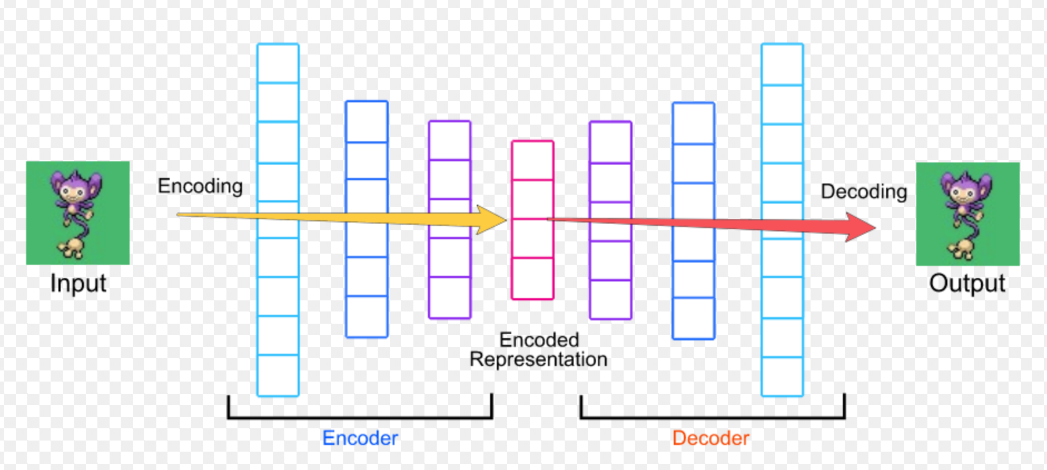
Auto-encoder is a neural network with the output layer having the same number of neurons as the input layer.
Auto-encoder

Slide 57
Auto-encoder
The purpose of using Auto-encoder is to reconstruct (recover) its input (X).
We want the output to be as close to input as possible

Slide 58
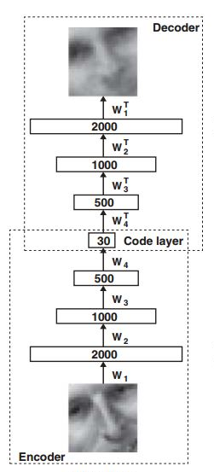
Why Auto-encoder can learn “true” features?
The ‘middle hidden layer’ has fewer neurons than the inputs.
Compress input data into a short code in such a way that when we uncompress that code, we can get input recovered.
The output from the ‘middle hidden layer’ are “true” features (embedding of the input).
This process forces ‘middle hidden layer’ to become good feature detectors for input
This process can also be referred to dimensionality reduction.

Slide 59
Popular deep learning architectures
Convolutional Neural Networks
Scenarios where spatially-closer data are more correlated
Recurrent Neural Networks
Data with temporal or sequential structures

Slide 60
Popular deep learning architectures
Convolutional Neural Networks
Scenarios where spatially-closer data are more correlated
Recurrent Neural Networks
Data with temporal or sequential structures

Slide 61
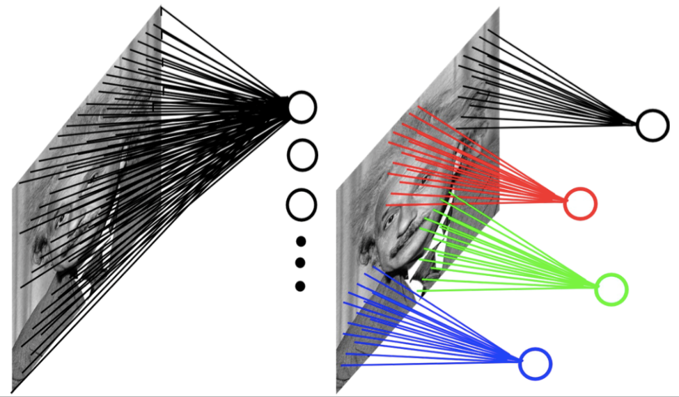
Convolutional Neural Network (CNN)
In CNNs, hidden neurons are only connected to local receptive field.
The number of weights (parameters) in CNNs is much smaller than a fully-connected neural network.
CNN is widely used in computer vision.
Example: 200x200 image
A fully connected layer: 40,000 input units X 40,000 hidden units => 1.6 billion connections (parameters)
A CNN layer: 5x5 kernel, 100 kernel => 2,600 parameters

Slide 62
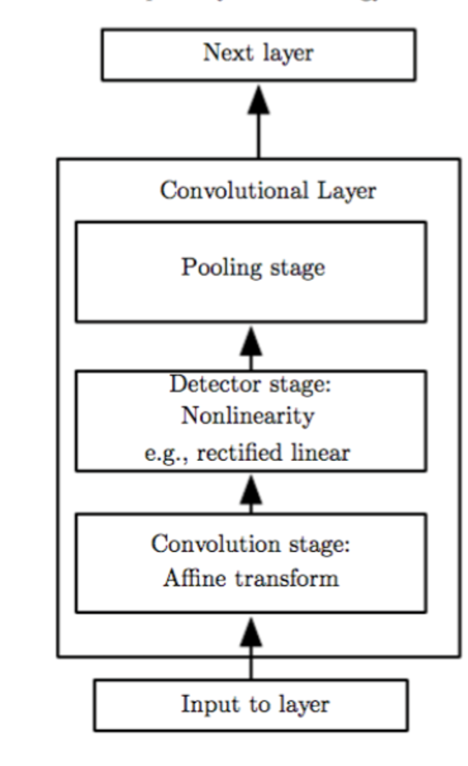
Three Stages of A Convolutional Operation
Convolution
Nonlinear transformation
Pooling

Slide 63
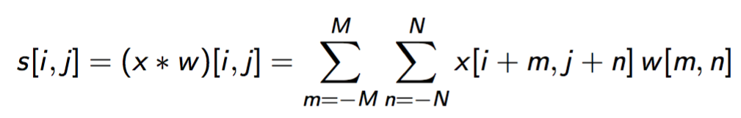
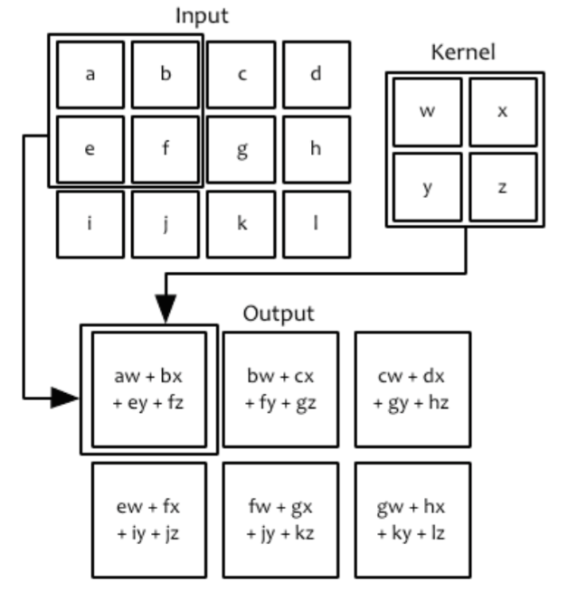
Convolution stage
Input: an image x (2-D array) x
Convolution kernel (2-D array of learnable parameters): w
Output: called feature map (2-D array of processed data): s
Convolution operation:

Slide 64

Single Convolution Kernel

Slide 65
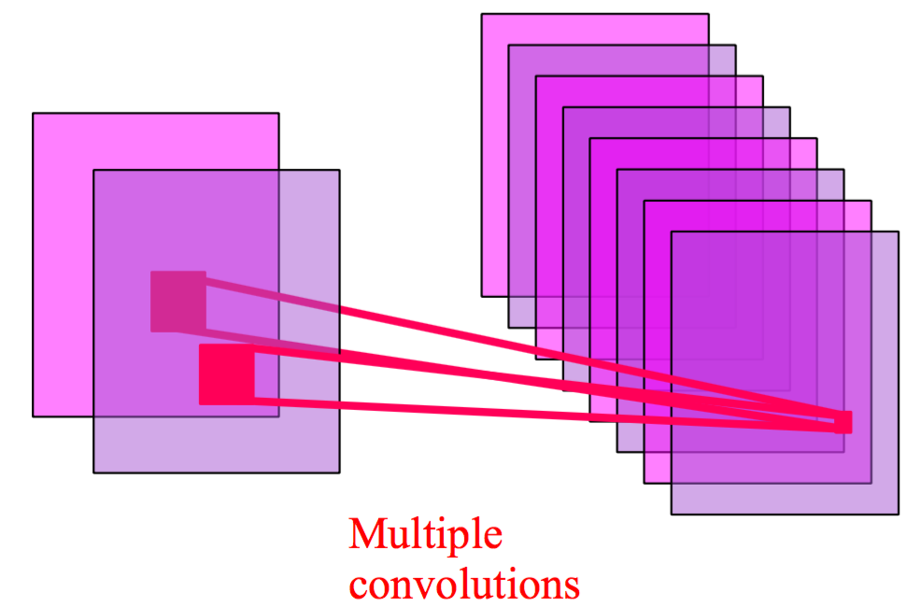
Multiple Convolution Kernels
Multiple convolution kernels yield multiple feature maps, one for each kernel.

Slide 66
Multiple Convolution Kernels
In TesorFlow, you should provide the following parameters to define each convolutional layer:
Number of filters/kernels
Kernel size (vertical, horizontal): the height and width of convolution window
Strides (vertical, horizontal): default strides=(1, 1)

Slide 67
Demo of multiple kernels
http://setosa.io/ev/image-kernels/

Slide 68
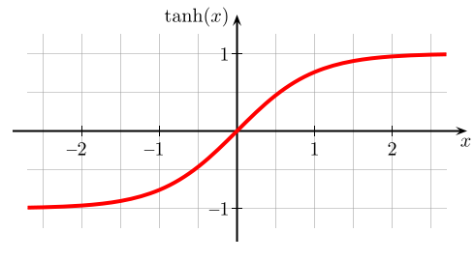
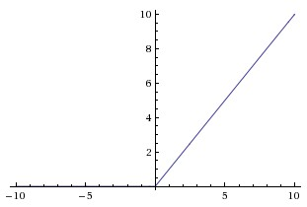
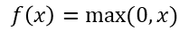
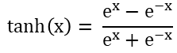
Nonlinear transformation
Tanh(x)
ReLU
$$\tanh\left(x\right)= \frac{e^{x}−e^{−x}}{e^{x}+e^{−x}}$$
$$f\left(x\right)=max⁡(0, x)$$

Slide 69
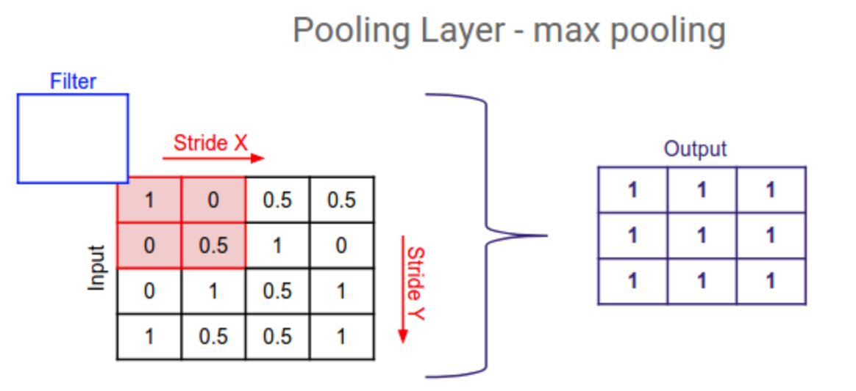
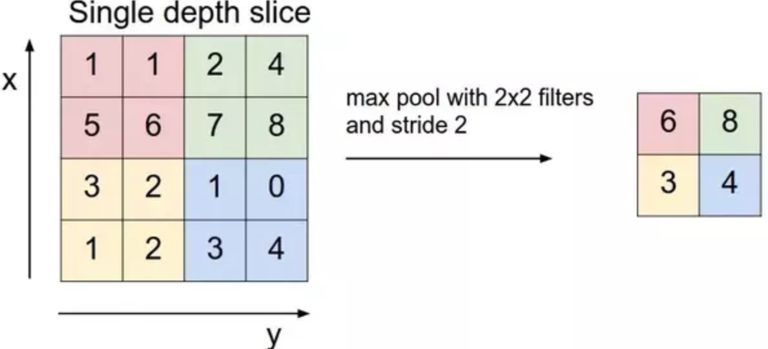
Pooling (downsampling strategy)
Common pooling operations:
Max pooling: reports the maximum output within a rectangular neighborhood.
Average pooling: reports the average output of a rectangular neighborhood.
Pool size (vertical, horizontal)
Stride value (vertical, horizontal)
Padding: "valid" or "same"

Slide 70
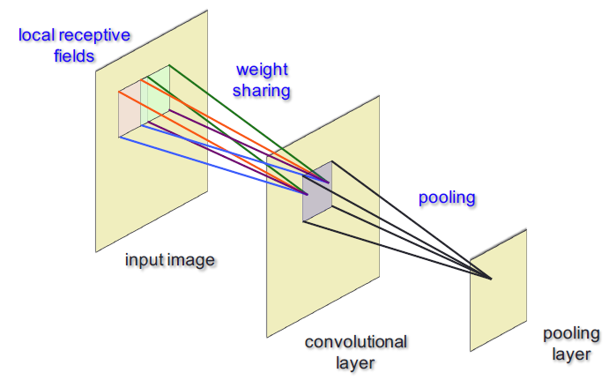
Each CNN operation (Conv + Nonlinear + Pooling)

Slide 71
Video on CNN

Slide 72
Note on CNN
You may use multiple convolution kernels (hidden neurons), which give you multiple feature maps.
You may stack multiple convolutional layers for extracting features at different levels.
Higher-level layers take the feature maps from lower-level layers as input.

Slide 73

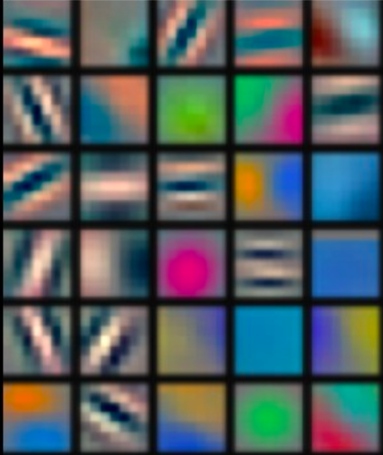
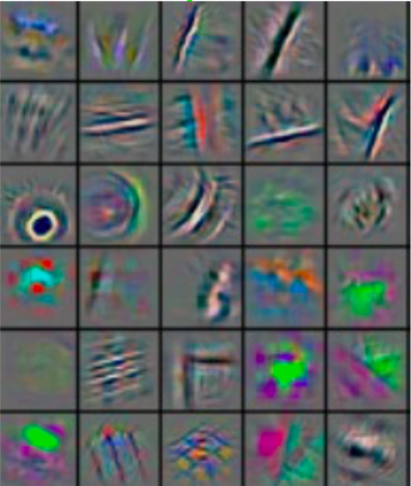
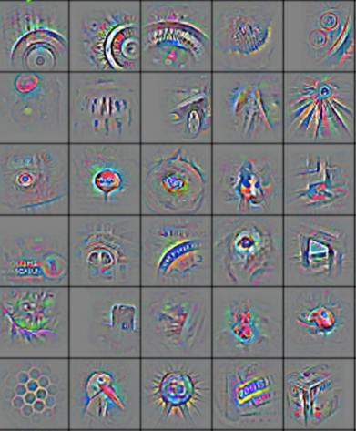
Deep CNN
CNN extracts features automatically through multiple layers.
Low-level features
Mid-level features
High-level features
Trainable classifier
output

Slide 74
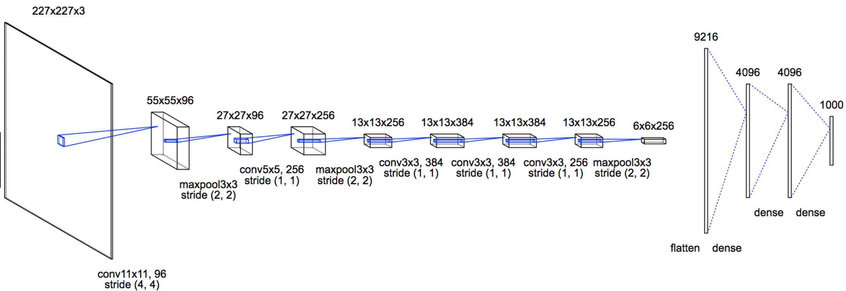
CNN for RGB Image Classification

Slide 75
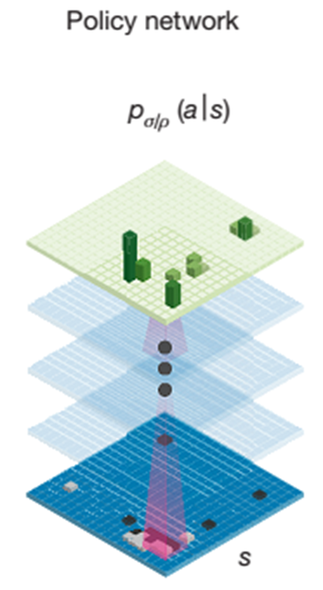
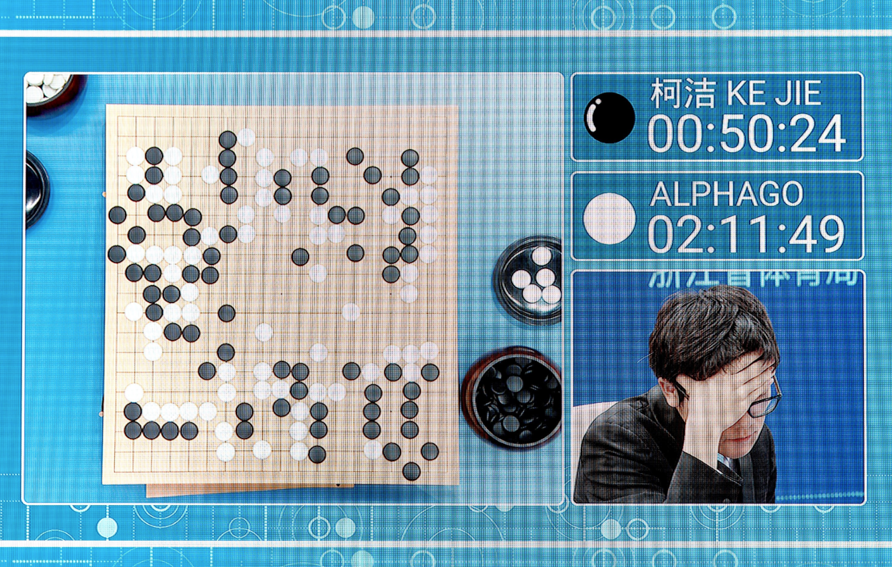
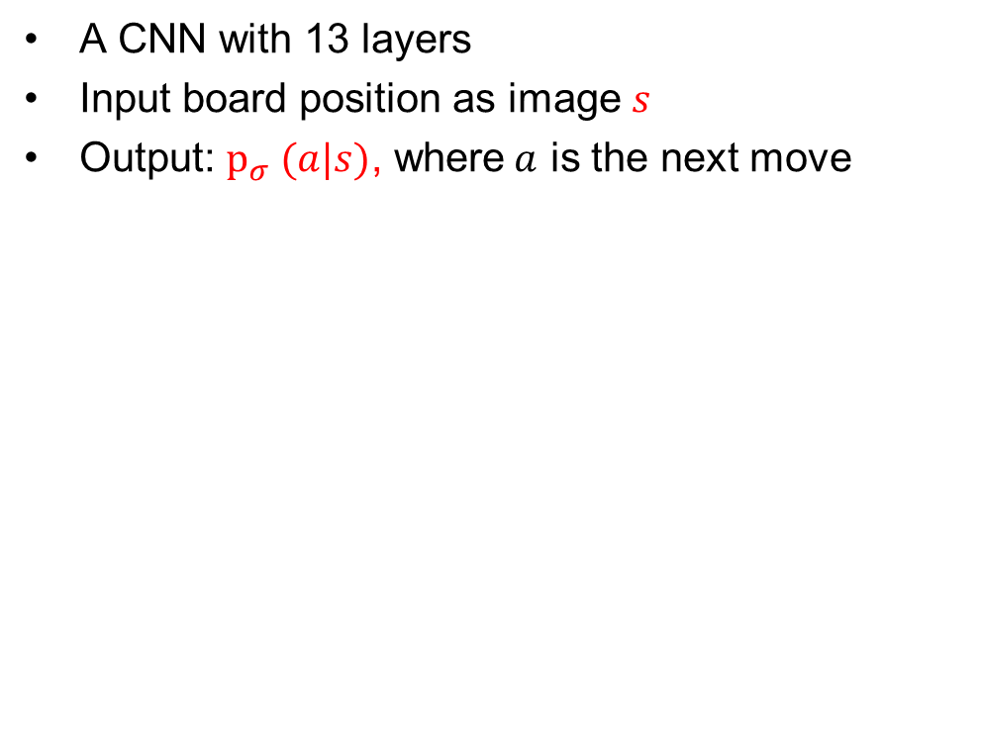
CNN in Alpha-Go
A CNN with 13 layers
Input board position as image $s$
Output: $p_{σ} (a|s)$, where$a$ is the next move

Slide 76
CNN for Image Classification
https://cs.stanford.edu/people/karpathy/convnetjs/

Slide 77
CNN talks
NVIDIA’s CES talk about their self-driving cars
YOLO

